Slide 1
Welcome to Arabic Level I by Kurzban

Slide 2
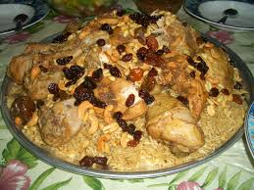

Slide 3

Lesson 2: الدرس الثاني
Objectives:
Identify yourself and others
Long and Short Vowels
Arabic alphabet: Two- way connectors
Practice
Summary
Review lesson 1

Slide 4

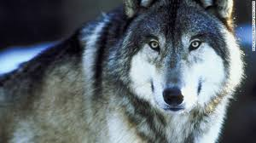
Identify the following subjects wolf.

Slide 5
Do Now
~Introduce the person you read about.
Review last class’s notes:
~What are the 6 letters that we have covered and what sound do they make?
~What are the formal and informal greetings we have learned about?
~How do you take leave?

Slide 6
Let’s practice
1} Copy the five letters on a ruled sheet of paper and practice writing them several times.
Remember: Your strokes should go from top to bottom and from right to left.

Slide 7
Arabic Alphabet: Two- way Connectors
ب ت ث ن ي

Slide 8
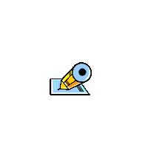
Arabic Alphabet: Two- way Connectors
ب ت ث ن ي
Initial Medial Final Connected Final unconnected
ب ب
ت ت
ث ث
ن ن ي

Slide 9
Arabic Alphabet: Two way Connectors
Name: Letter: Example:
Ba ____________________ Ball
Ta ____________________ Trouble
*Tta ____________________ Thin
nun ____________________ nine
ya _____________________ Yemen
The Arabic alphabets contains 28 letters in addition to the hamza and two other variants of existing letters.

Slide 10
Let’s practice
ا + ب +ن =
ت + ي + ن =
ب+ ن +ت=
ت+ ب + ن =
Remember: Your strokes should go from top to bottom and from right to left

Slide 11
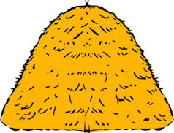
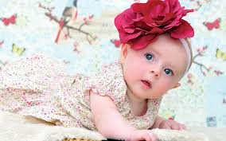
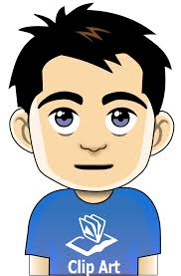
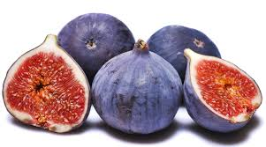

Slide 12

Identifying yourself & Others
I am (ana)________________ انا
& he ( huwa)____________________ و هو؟ Masculine
& she ( hiya) __________________ وهي؟ Feminine

Slide 13
Agree/ Disagree
نعم
لا

Slide 14
Lesson 2: Identifying yourself & Others
I am (ana)_______________ انا
  & you (anta) ___________________و انت؟ Masculine
  & you ( anti) __________________و انت؟ Feminine

Slide 15
Summary
Examine these sentences and identify the letters that we have discussed by circling them
بنت عمي مدرسة.
يَقْرَأُ الْوَلَدُ كِتَاْبَه

Slide 16
Summary
Examine these sentences and identify the letters that we have discussed by circling them
في أسرتي ثلاثة أفراد.

Slide 17
Review
Make a flash card for lesson 1. You are responsible to know and understand everything that was previously covered.

